Slide 1
A study on Similar Neighborhoods in First world countries

Slide 2
Introduction
1.1 Problem and a discussion of the background
Immigration is the process of moving to a new country or region with the intention of staying and living there.
People may choose to immigrate for a variety of reasons, such as employment opportunities, to escape a violent conflict, environmental factors, educational purposes, or to reunite with family.Research suggests that migration is beneficial both to the receiving and sending countries
.So to where do people prefer to migrate ??
1.The US primarily:
2. Germany,
3. Canada,
4. The United Kingdom,
5. France,

Slide 3
So in this project I consider the major cities to where immigration happens the most.
1. Manhattan, NYC , US
2. Toronto , Canada
3. Berlin, Germany
4. Paris , France
These cities attract the majority of Foreign Immigration.

Slide 4
Data
New York City data containing the neighborhoods and boroughs, latitudes, and longitudes will be obtained from the data source: https://cocl.us/new_york_dataset
Toronto data containing the neighborhoods and boroughs, latitudes, and longitudes will be obtained from the data source: https://en.wikipedia.org/wiki/List_of_postal_codes_of_Canada:_M
Berlin, Germany data containing the neighborhoods and boroughs, latitudes, and longitudes will be obtained from the data source: https://en.wikipedia.org/wiki/Boroughs_and_neighborhoods_of_Berlin
Paris,France data containing the neighborhoods and boroughs, latitudes, and longitudes will be obtained from the data source: https://en.wikipedia.org/wiki/Arrondissements_of_Paris
All data related to locations and details of Food venues will be obtained via the FourSquare API utilized via the Request library in Python.

Slide 5
Methodology
• Data will be collected from the above links and cleaned and processed into a dataframe.
• FourSquare is used to locate all venues related to food and then filtered by restaurants.
• Data will be clustered based on the top venues.
• Finally, the data will be visually assessed using graphing from various Python libraries.

Slide 6
Problem Statement
Which is the best cuisine in different First world countries?
Which Neighborhoods are similar?
Which is the most common type of Restaurant type in these cities?

Slide 7
Working
First the data from different websites are combined to a single dataframe.
Getting Restaurant data from dataframe
First the Venue Category in which the word Restaurant is present will be identified and stored in an array.
Secondly, the rows with Venue Category in the array will be added into another dataframe for clustering.

Slide 8
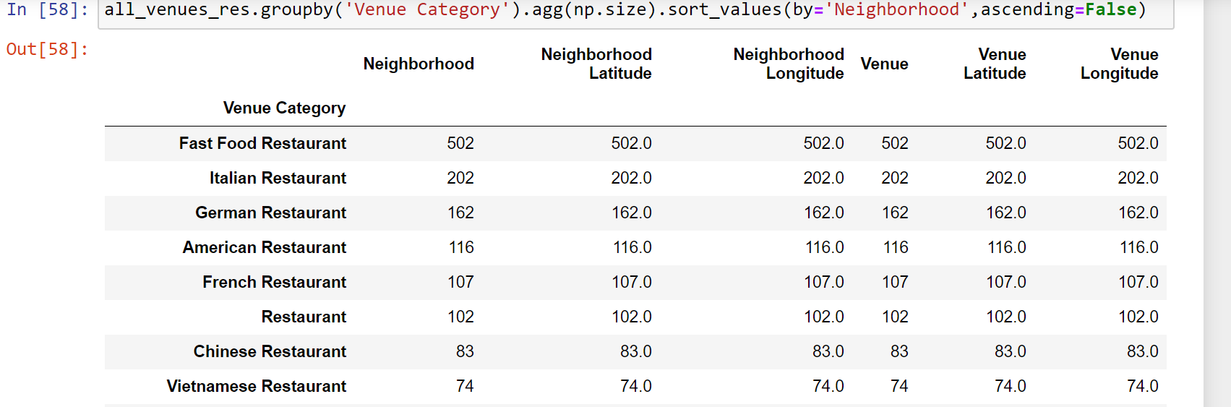
With the table obtained it is clear that Italian Food is the most liked Cuisine in these major cities.
Also Fast Food Restaurants are the most common Food Chain available in these cities.
This shows the people’s like towards the Fast Food type Restaurants.

Slide 9
We can ignore the Fast Food Restaurants, as being a major Tourist spot Fast Food Restaurants will be common in these Cities.
And the other Restaurant in the list is obvious because we tried the cities from these countries itself.
Then the top 10 venues of each neighborhood are encoded and clustering is applied on this data.
Now we will try to cluster different Neighborhoods together. Our aim was to check whether the First world Cities have anything in common.
Through clustering it will be clear whether the taste of different cities are the same?

Slide 10
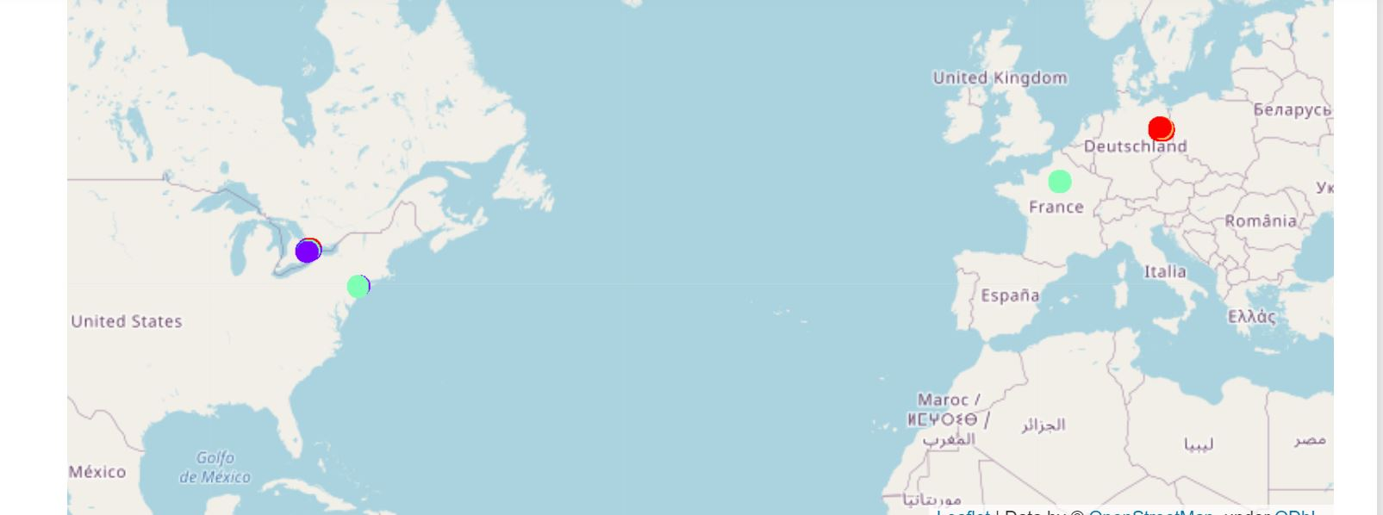

Slide 11
Results /Conclusion
The similar neighborhoods are displayed as clusters.
The boroughs and Neighborhoods of Manhattan and Paris are similar.
Both the places have similar percentages(around 25%) of immigrants from all over the world. Both places are known for their diverse types of Cuisines available, and this is mainly due to the immigration from other countries or the second generation of immigrants.
Some localities from Berlin and Toronto also match these neighborhoods, but mainly it follows unique clusters.
Berlin and Toronto have only less neighborhoods which have similarity with each other.
Since the majority of immigrants to Germany are from Middle Eastern Countries like Turkey, Syria etc.
And major immigration in toronto is from European Countries and Asian Countries.Which shows the uniqueness in the type of restaurants in these countries.

Slide 12
By considering the table with the restaurant list it is clear that Italian Cuisine is the most famous cuisine in these areas.
The cities had a majority of restaurants with their own cuisine but all these four cities had a good number of Italian Restaurants also.
It also shows the Italian Population in these areas. Manhattan and Toronto are considered as cities with the majority of Italian immigrants or their descendants.
So we can say Italian Cuisine is the most famous Foreign Cuisine in these areas

Slide 13
Also from the table it was clear that Fast Food Restaurants topped the list in number.
A fast food restaurant, also known as a quick service restaurant (QSR), is a specific type of restaurant that serves fast food cuisine and has minimal table service.
While researching it was clear the Fast Food Restaurants are considered as quick, cheap and available as take away which helps the busy working class in these cities.
Since being the economic centres of the world, these four cities have a large population of the working class

Slide 14
Discussion
The Italian population in these cities have an effect on the number of Italian Restaurants in these areas.
In all these cities Cuisines of all different countries are available. So people love to try other countries Cuisines.

Slide 15
Conclusion
This project focused mainly on the research part rather than the product part. Extensive research was carried out to find out the demographics of these countries and the ethinic groups residing in these cities. But since the research depends on minimum data the findings may be right or wrong. But if a good amount of data is available we can come up with better results in future.
The results supported our research. More research will help in finding out whether the immigrant group is active in the society or not.

